Slide 1


Single-Page Application and Routing
Using Vue-router, Guards, Data Fetching
SoftUni Team
Technical Trainers
Software University
https://softuni.bg

Slide 2
Table of Contents
Routing Overview
VueJS Router
Installation & Basic Setup
Router Links
Parameters
Redirects
Navigation Guards
Data Fetching
2

Slide 3
Have a Question?
sli.do #js-frameworks

Slide 4
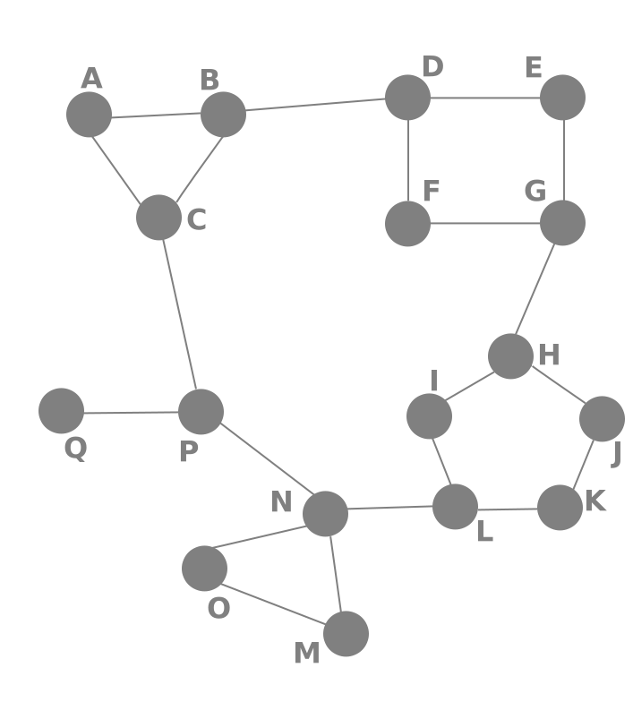
Routing Overview
Navigation for Single Page Applications

Slide 5


What is Routing?
Allows navigation, without reloading the page
Pivotal element of writing Single Page Applications
HTML
HTML
HTML
Link
HTML
HTML
ROUTER
Link
HTML
HTML
HTML
HTML
Link
Standard Navigation
Navigation using Routing
5

Slide 6

Single Page Applications
A Router loads the appropriate content when the location changes
Conversely, a change in content is reflected in the address bar
Benefits
Load all scripts only once
Maintain state across multiple pages
Browser history can be used
Build User Interfaces that react quickly

Slide 7
VueJS Router
Installation, Setup, Router Links, Params, Redirects

Slide 8
The VueJS Router
The Router integrates with Vue.js core to make building Single Page Applications a breeze
Features include
Nested route/view mapping
Modular, component-based router configuration
Route params, query, wildcards
Fine-grained navigation control
HTML5 history mode or hash mode, with auto-fallback in IE9
8

Slide 9
Router Installation
To install the vue router
When used with a module system, you must explicitly install the router
npm install vue-router
import Vue from 'vue'
import VueRouter from 'vue-router'
Vue.use(VueRouter)
9

Slide 10
Setup Basic Routes
Create a routes.js and export a couple of routes
Array of Objects
Path and Component to load
export const routes = [
{ path: '', component: Home },
{ path: '/user', component: User },
{ path: '/user/:id', component: UserDetails }
];
10

Slide 11
Setup Basic Routes
Create a router instance and import it inside the root instance
const vueRouter = new VueRouter({
routes
});
new Vue({
el: '#app',
router: vueRouter,
render: h => h(App)
});
11

Slide 12
Router View
Add a place where the components will be loaded
Use the <router-view></router-view> tag
// route outlet
// component matched by the route will render here
<router-view></router-view>
12

Slide 13
Routing Modes
The default mode for vue-router is hash mode
Uses the URL hash to simulate a full URL so that the page won't be reloaded when the URL changes
To get rid of the hash, we can use the router's history mode
const router = new VueRouter({
mode: 'history',
routes: [...]
});
13

Slide 14
Navigating with Router Links
Declarative Navigation with <router-link>
Add a tag to wrap up the element with it
<router-link to="/login">Login View</router-link>
<router-link tag="li" to="/login">Login View</router-link>
14

Slide 15

Dynamic Router Links
Bind the link to a data property and make it dynamic
<router-link
tag="button"
:to="link"
>Go to Edit</router-link>
data(){
return { link: 'user/edit' }
}
15

Slide 16
Imperative Navigation
Aside from using <router-link> to create anchor tags for declarative navigation
We can do this programmatically using the router's instance methods
// literal string path
This.$router.push('home');
// object
This.$router.push({ path: 'home' });
16

Slide 17
Setup Route Parameters
Setup route parameters using the colon ':'
{
path: 'user/:id', component: UserDetails
},
{
path: 'user/edit/:id', component: UserEdit
}
17

Slide 18
Fetch Route Parameters
Fetch parameters from local $route object
data() {
return {
id: this.$route.params.id, // ID's
query: this.$route.query // Query Objects
fragment: this.$route.hash // Hash Fragments
}
}
18

Slide 19
Reacting to Route Changes
React the changes whenever a parameter changes on the same view using a watcher
watch: {
'$route'(to, from) {
// Do something when a parameter changes
}
}
19

Slide 20
Setup Nested Routes
Setup nested/child routes with the children property
{
path: '/user', component: UserStart, children: [
{ path: ':id', component: UserDetail }
{ path: ':id/edit', component: UserEdit }
]
}
<router-view></router-view>
Add a new router view to the UserStart
20

Slide 21
Named Routes
Sometimes it is more convenient to identify a route with a name
{ path: '/user/:id', name: 'userEdit', component: UserEdit }
<router-link :to="{ name: 'userEdit', params: { id: 123 }}">
User Edit
</router-link>
This.$router.push({ name: 'userEdit', params: { id: 123 }})
21

Slide 22

Redirecting
Redirecting is also done in the routes configuration
routes: [
{ path: 'redirect-me', redirect: '/user' },
{ path: 'another-redirect', redirect: '/' }
]
22

Slide 23
Wildcards
Setup a "catch all" wildcard route
Matches absolutely every route and should be at the bottom
routes: [
{ path: '*', component: NotFound },
]
23

Slide 24

Navigation Guards
Global, Pre-Route, In-Component

Slide 25

Definition
Used to guard navigations either by redirecting it or canceling it
There are a number of ways to hook into the route navigation process
Globally
Per-route
In-component
25

Slide 26
Global Guards
You can register global before guards using router.beforeEach
const router = new VueRouter({ ... })
router.beforeEach((to, from, next) => {
next();
});
Resolve the hook
26

Slide 27
The Next Function
This function must be called to resolve the hook
The action depends on the arguments provided to next
next() - move on to the next hook in the pipeline
next(false) - abort the current navigation
next(pathString) - redirect to a different location
next(error) - abort and pass error callbacks

Slide 28
Pre-Route Guard
You can define beforeEnter guards directly on a route's configuration object
{
path: '/login',
beforeEnter: (to, from, next) => {
if (isAuth) {
next(false);
}
}
}
28

Slide 29
In-Component Guard
Finally, you can directly define route navigation guards inside route components
beforeRouteEnter (to, from, next) {
// called before component is rendered
// does NOT have access to "this" component instance
},
beforeRouteLeave (to, from, next) {
// called before redirect
// has access to "this" component instance
}
29

Slide 30

Data Fetching
Before and After Navigation

Slide 31
Definition
Sometimes you need to fetch data from the server when a route is activated
Before rendering a user profile
Loading a post by id
We can achieve this in two different ways
Fetching before navigation
Fetching after navigation
31

Slide 32
After Navigation
Call a method inside the created() hook
data() { return { users: [] } },
created() {
this.fetchUsers();
},
methods: {
fetchUsers() {
// TODO fetch users from an API
}
}
32

Slide 33
After Navigation
Conditionally render the data
<div v-if="loading" class="loading">
Loading...
</div>
<div v-if="error" class="error">
{{ error }}
</div>
<div v-if="users" class="content">
</div>
33

Slide 34
Before Navigation
Perform the data fetching in the beforeRouteEnter guard in the incoming component
beforeRouteEnter(to, from, next) {
fetchUsers()
.then(data => {
next((vm) => { vm.setData(null, data) });
})
}
34

Slide 35

Before Navigation
Create a method to set the data or error
methods: {
setData(err, users) {
if (err) {
this.error = err;
} else {
this.users = users;
}
}
}
35

Slide 36

Summary
…
…
…
SPA - navigation without reloading the page
VueJS Router - official library for routing
Router Links, Redirects, Parameters, Nested Routes
Navigation Guards - useful for intercepting routes and data fetching

Slide 37
Questions?
Notes:
37

Slide 38












SoftUni Diamond Partners

Slide 39




SoftUni Organizational Partners

Slide 40
Trainings @ Software University (SoftUni)
Software University - High-Quality Education, Profession and Job for Software Developers
softuni.bg, softuni.org
Software University Foundation
softuni.foundation
Software University @ Facebook
facebook.com/SoftwareUniversity
Software University Forums
forum.softuni.bg
40
Notes:
40

